Slide 1


Science at Tollgate
Science
#TeamTollgate

Slide 2
Overview
Science, as a core subject, is taught weekly using the structure of CUSP with adaptations. We place knowledge, vocabulary, working and thinking scientifically at the heart of our principles, structure and practice.
The weekly lessons allow for the ongoing revision needed to move the knowledge into long-term memory. The curriculum is carefully designed to allow for revisiting topics and key concepts. Science enquiry skills, working scientifically and vocabulary are explicitly taught from nursery onwards with a view to building content and understanding from year to year.
#TeamTollgate

Slide 3
National Curriculum
The national curriculum for science aims to ensure that all pupils:
• develop scientific knowledge and conceptual understanding through the specific disciplines of biology, chemistry and physics
• develop understanding of the nature, processes and methods of science through different types of science enquiries that help them to answer scientific questions about the world around them
• are equipped with the scientific knowledge required to understand the uses and implications of science, today and for the future
Throughout the curriculum, one main aim is to maintain the curiosity that children naturally have in the early years. Added into the curriculum are opportunities for further scientific methodology with key STEM challenges related to the topics taught.
#TeamTollgate

Slide 4
Early Years
In Early Years, children are encouraged to become scientists. Children’s understanding of the world is developed by being encouraged to explore, investigate and manipulate objects. Children regularly take their Science learning outside. With specific focuses, children are able to make sense of the world and community around them. Early years is all about exploring and investigating the world, and Science combines these two key elements. It also connects all other areas of learning, for example language, describing what’s happening in an experiment and learning new vocabulary. Science in Nursery and Reception is about raising questions and seeking answers. In Nursery, the outdoor environment is ideal for setting up imaginative and exciting learning opportunities.
Children will:
Show curiosity and interest in physical objects
Talk about and describe what they see
Show an awareness of change
Ask appropriate questions
Explain their understanding and share their own knowledge
Investigate objects using all 5 senses
Observe changes in the environment carefully
Experiment with nature.
#TeamTollgate

Slide 5
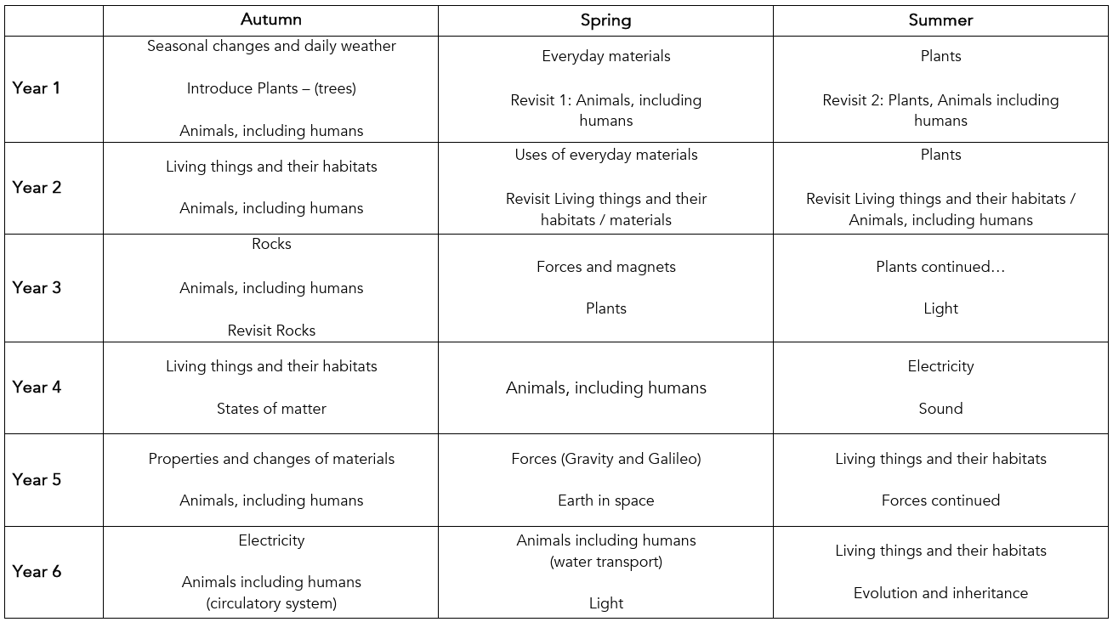
Key Stage 1 & 2 Progression overview
We use the 6 phases of CUSP in our Science lessons:
• Connect
• Explain
• Example
• Attempt
• Apply
• Challenge
Pupils use Knowledge Notes to help them navigate the concepts taught with explicit vocabulary instruction built into the 6 phases of the lesson.
Socrative Quizzing is used for retrieval practice as a knowledge check. In addition, Digital Thinking Hard Tasks are used to enable all pupils to attempt and make sense of the content through deliberate practice.
The CUSP Science curriculum is built on a concentric and cumulative model. We have deliberately positioned complex concepts and content to be revisited, so secure foundations can be built.
#TeamTollgate

Slide 6
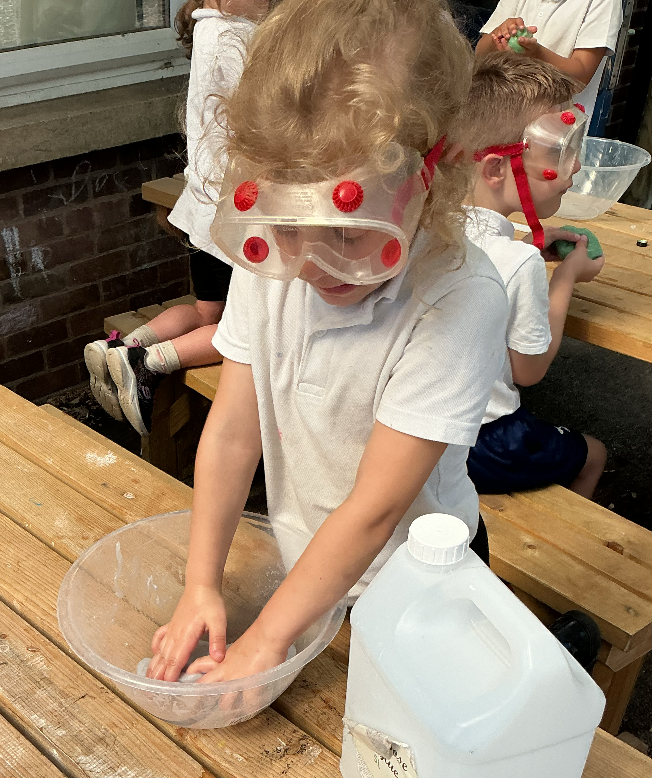
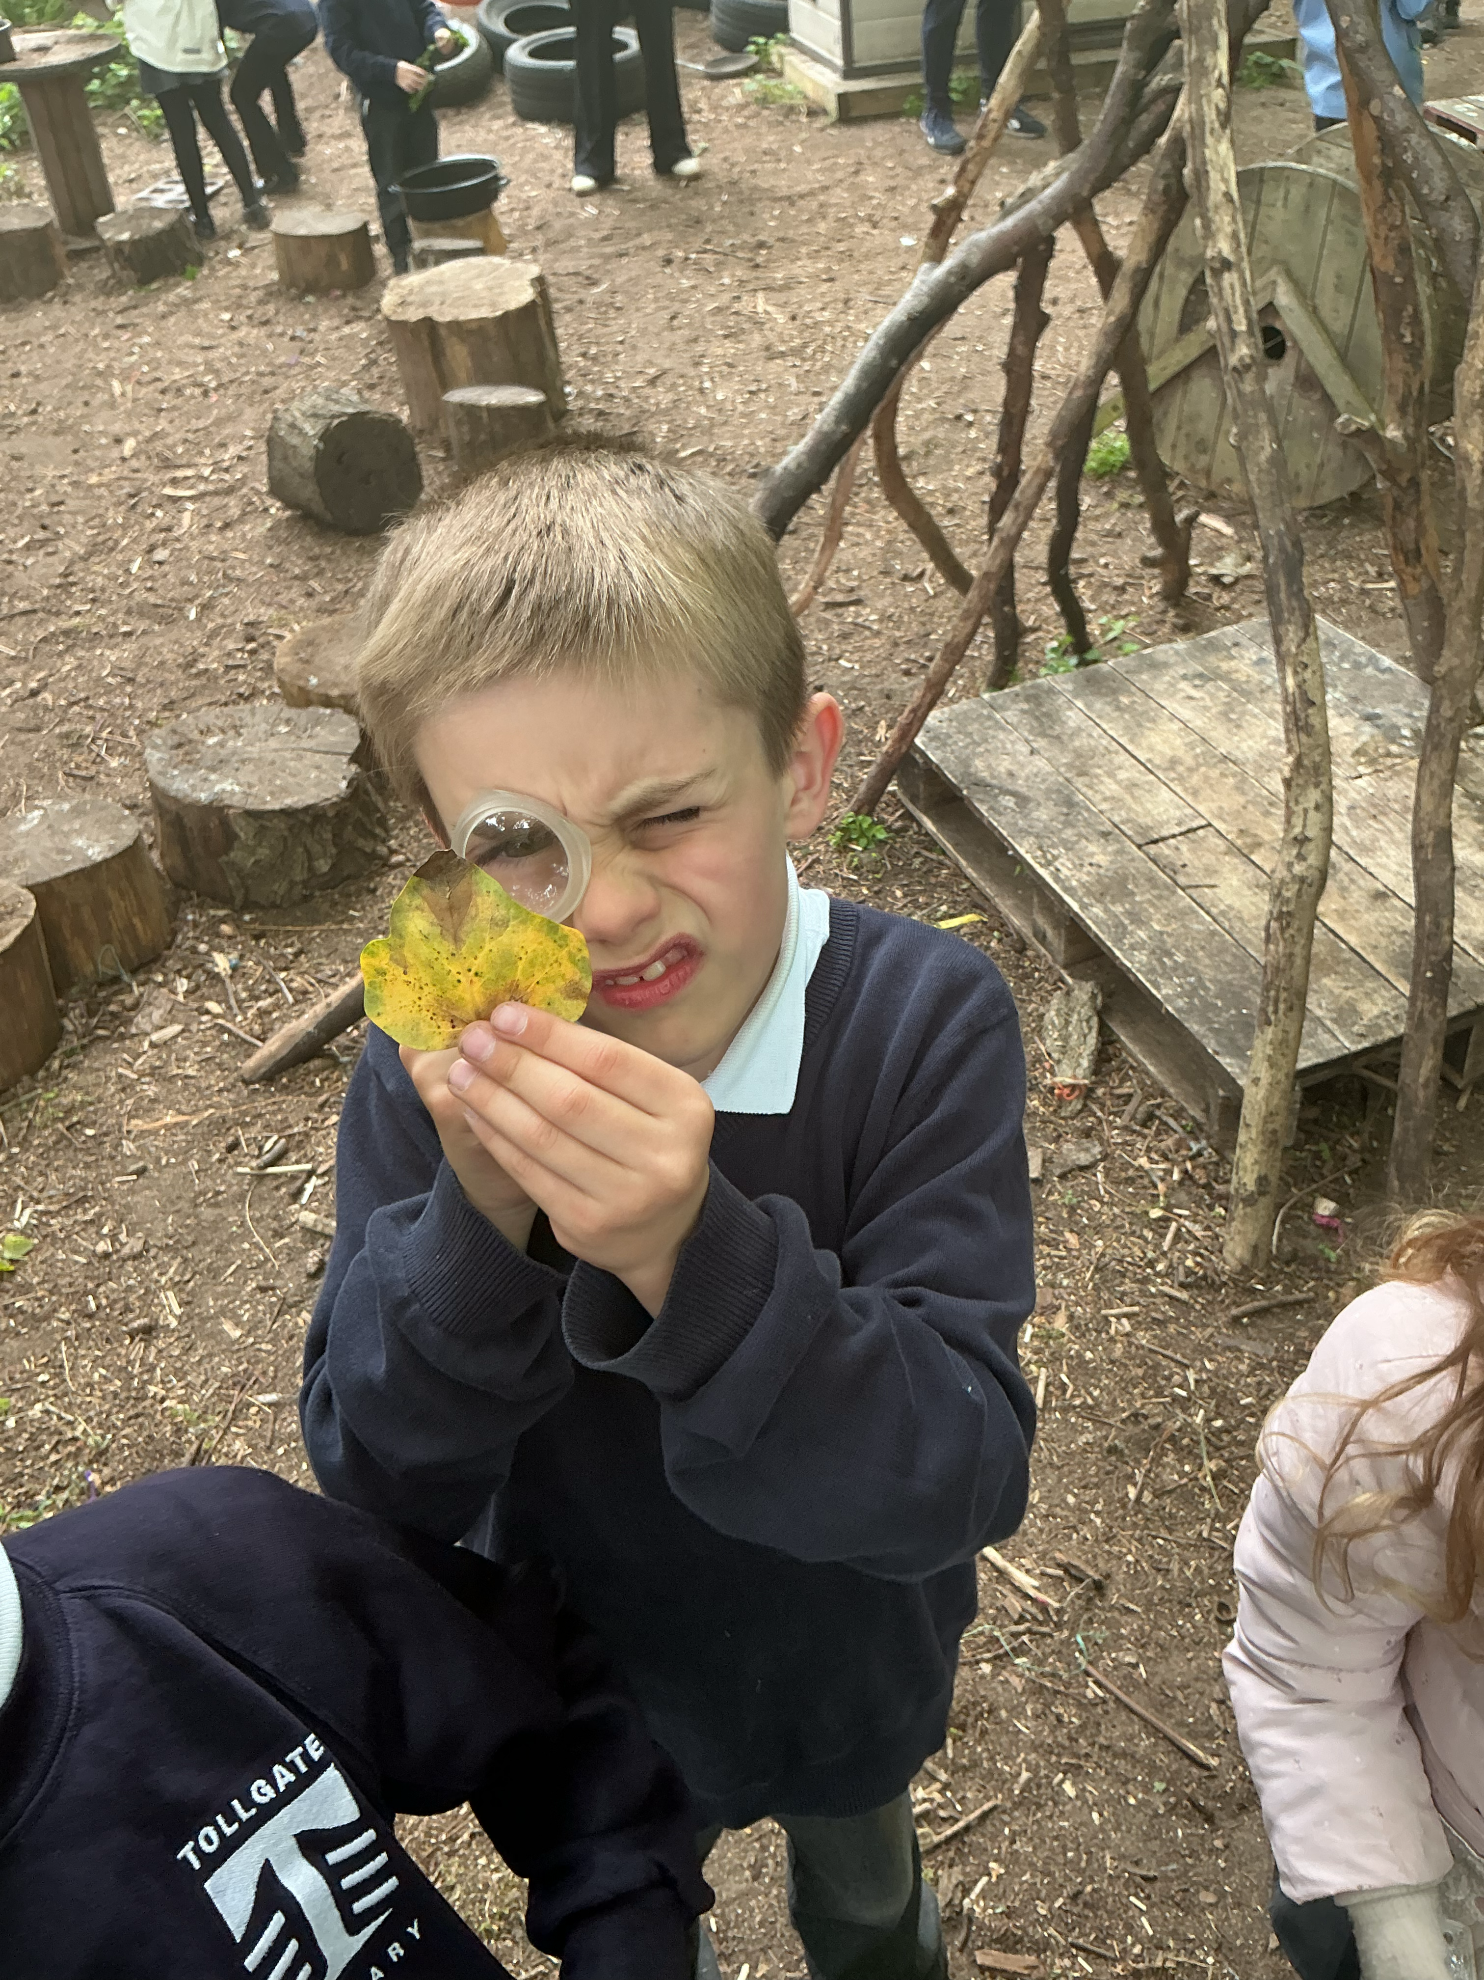
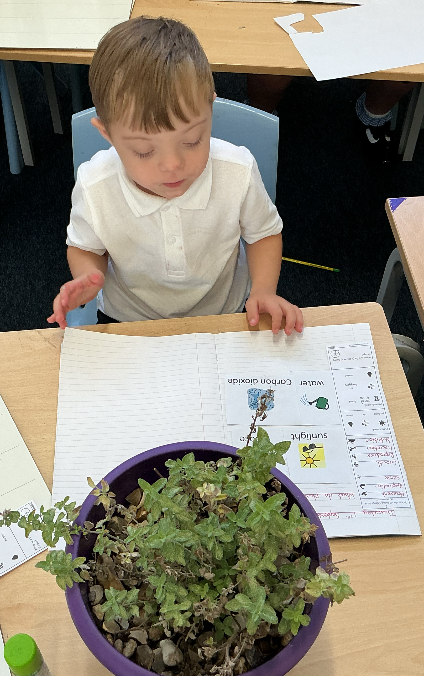
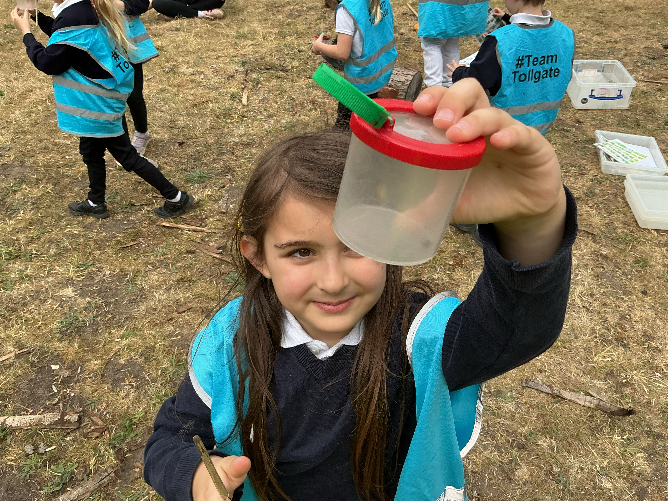
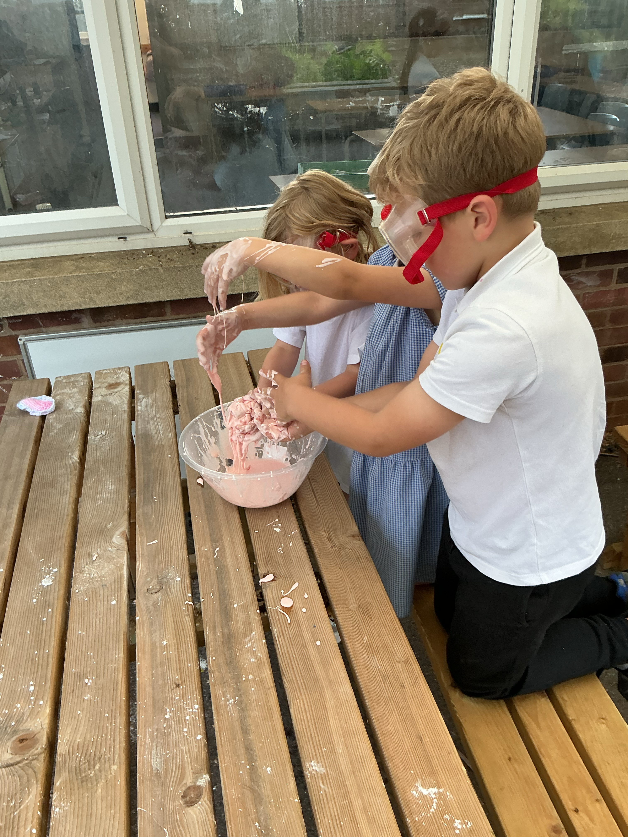
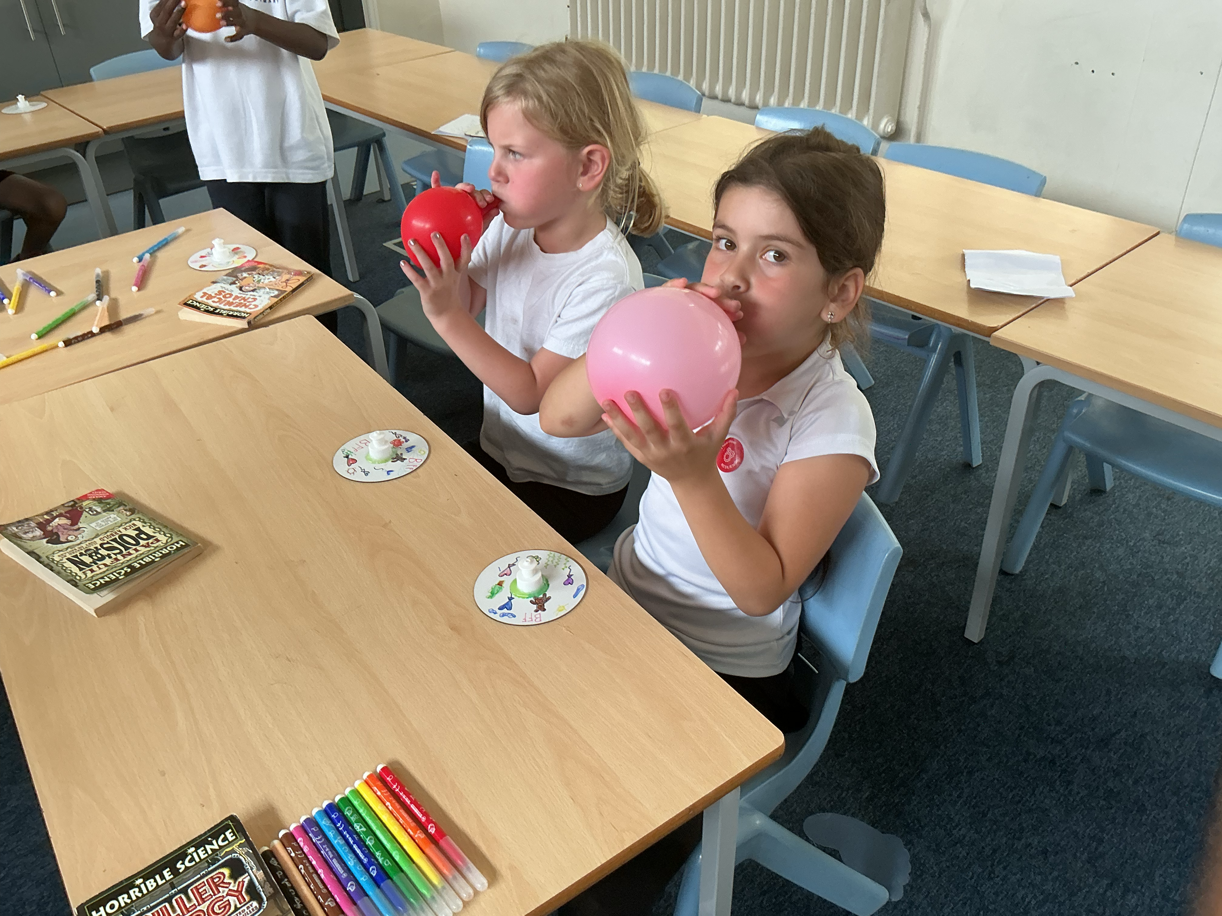
Science at Tollgate
Pupils will regularly take part in science experiments in class getting the chance to actively work scientifically.
As well as in class pupils will have further opportunities to develop their enquiry skills in KS1 science club, forest school, trips and guest speakers.
#TeamTollgate

Slide 7
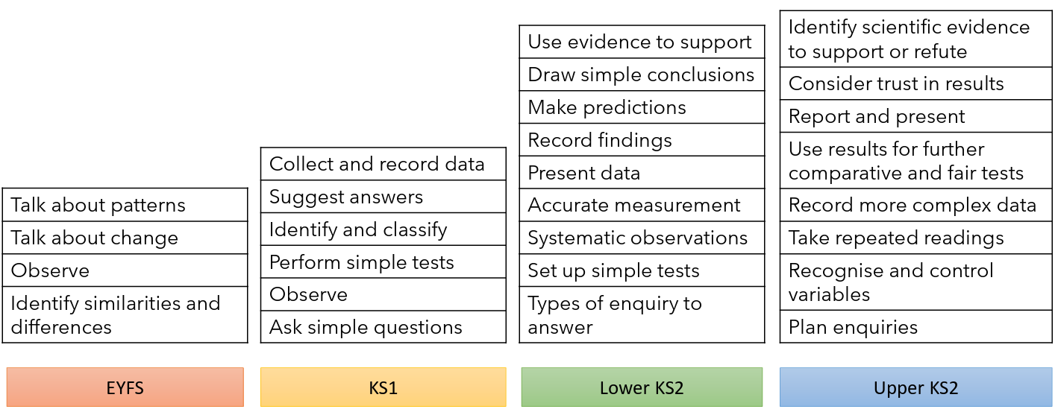
Working Scientifically
#TeamTollgate

Slide 8
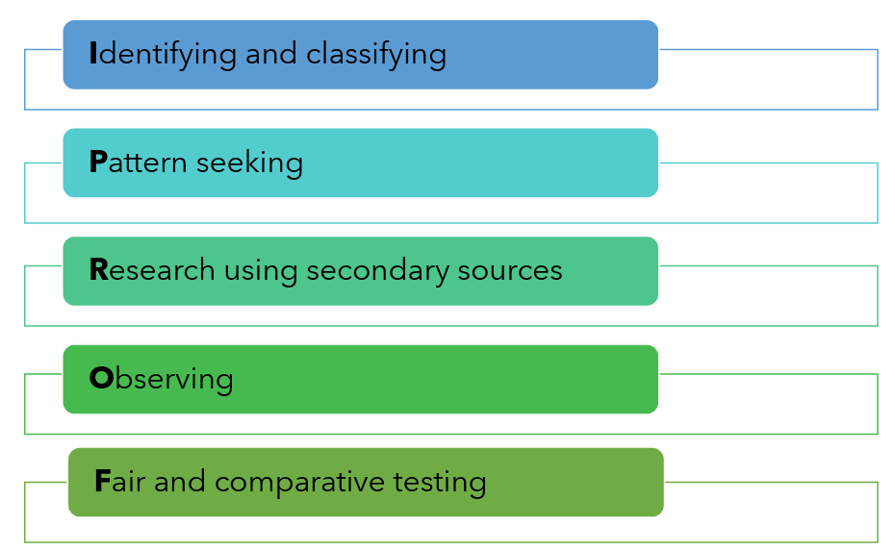
Science Enquiry Skills
#TeamTollgate

